Slide 1

Welcome By: ROHIT_KUMAR

Slide 2

TOPIC
SQL JOINS

Slide 3
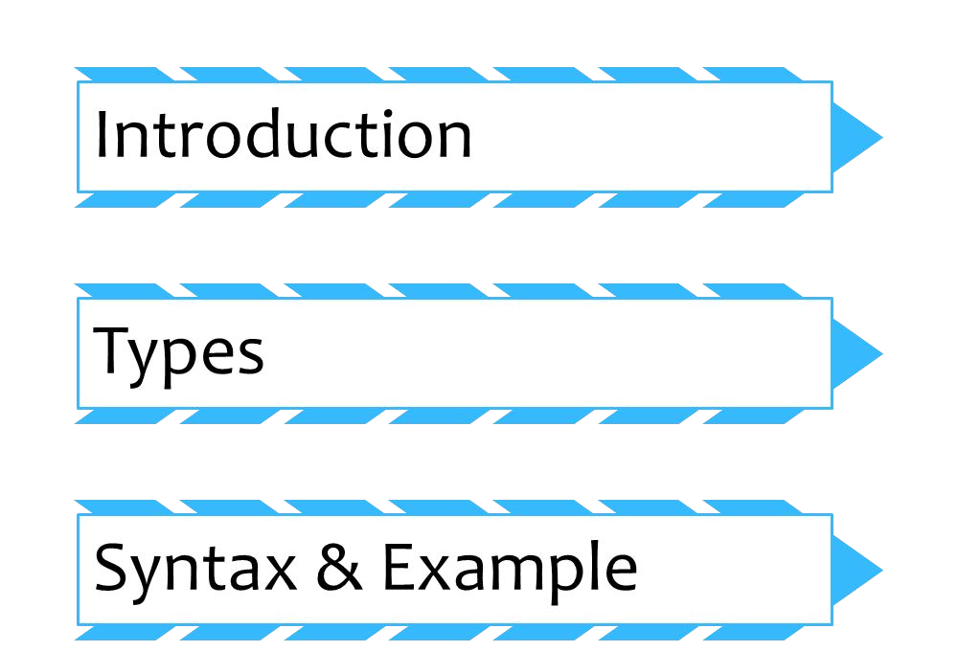
CONTENT

Slide 4

INTRODUCTION
WHAT IS JOINNING???

Slide 5
DEFINITION
A SQL join clause combines columns from one or more tables in a relational database. It creates a set that can be saved as a table or used as it is.
A JOIN is a means for combining columns from one (self-table) or more tables by using values common to each.

Slide 6
TYPES
Full Join
Left Join
Right Join
Inner Join

Slide 7
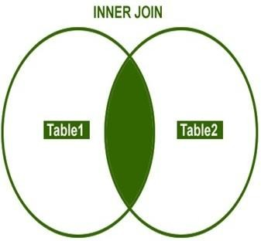
INNER JOINS
I.INNER JOIN
Inner join returns only those records that match in both the tables.
Syntax:
Select * from table 1 INNER JOIN table 2
ON
Table 1.Column 1=table 2.Column 1

Slide 8
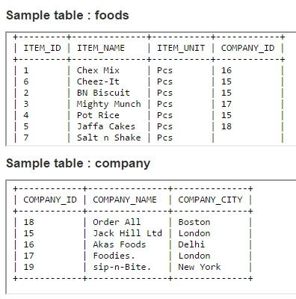
SCENARIO

Slide 9
INNER JOINS
QUARY:
SELECT foods.item_name,foods.item_unit, company.company_name,company.company_city FROM foods INNER JOIN company
ON foods.company_id =company.company_id;
Result:
ITEM_NAME | ITEM_ | COMPANY_NAMECOMPANY_CITY
Chex Mix | Pcs | Akas Foods | Delhi
Cheez-It BN Biscuit Mighty Munch Pot Rice Jaffa Cakes | Pcs Pcs Pcs Pcs Pcs | Jack Hill Ltd Jack Hill Ltd Foodies. Jack Hill Ltd Order All | London London London London Boston

Slide 10
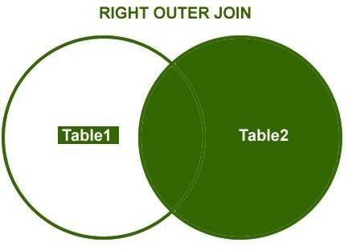
RIGHT JOINS
a. Right Join
Right outer join returns all records/rows from right table and from left table returns only matched records.
Syntax:
Select * from Table 1 Right Join Table 2 ON
Table 1.Column 1=Table 2.Column 1

Slide 11
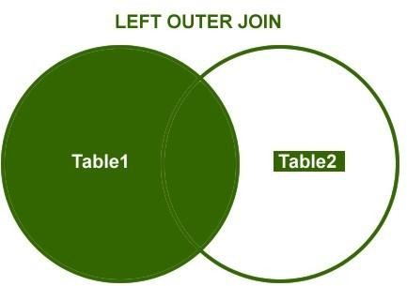
LEFT JOINS
b. Left Join
Left outer join returns all records/rows from left table and from right table returns only matched records.
Syntax:
Select * from Table 1 Left Join Table 2 ON
Table 1.Column 1=Table 2.Column 1

Slide 12
SCENARIO

Slide 13
RIGHT JOINS
QUARY:
SELECT company.company_id,company.company_name, company.company_city,foods.company_id,foods.item_name FROM company
RIGHT JOIN foods
ON company.company_id = foods.company_id;
RESULT:
COMPANY_ID
COMPANY_NAME
COMPANY_CITY
COMPANY_ID ITEM_NAME
18 |  | Order All |  | Boston |  | 18 |  | Jaffa Cakes
15 |  | Jack Hill Ltd |  | London |  | 15 |  | Pot Rice
15 |  | Jack Hill Ltd |  | London |  | 15 |  | BN Biscuit
15 |  | Jack Hill Ltd |  | London |  | 15 |  | Cheez-It
16 |  | Akas Foods |  | Delhi |  | 16 |  | Chex Mix
17 |  | Foodies. |  | London |  | 17 |  | Mighty Munch
 |  |  |  |  |  |  |  | Salt n Shake

Slide 14
LEFT JOINS
QUARY:
SELECT company.company_id,company.company_name, company.company_city,foods.company_id,foods.item_name FROM company
LEFT JOIN foods
ON company.company_id = foods.company_id;
RESULT:
COMPANY_ID
COMPANY_NAME
COMPANY_CITY
COMPANY_ID
ITEM_NAME
16 | Akas Foods | Delhi | 16 | Chex Mix
15 | Jack Hill Ltd | London | 15 | Cheez-It
15 | Jack Hill Ltd | London | 15 | BN Biscuit
17 | Foodies. | London | 17 | Mighty
15 | Jack Hill Ltd | London | 15 | Pot Rice
18 | Order All | Boston | 18 | Jaffa Cakes
19 | sip-n-Bite. | New York

Slide 15
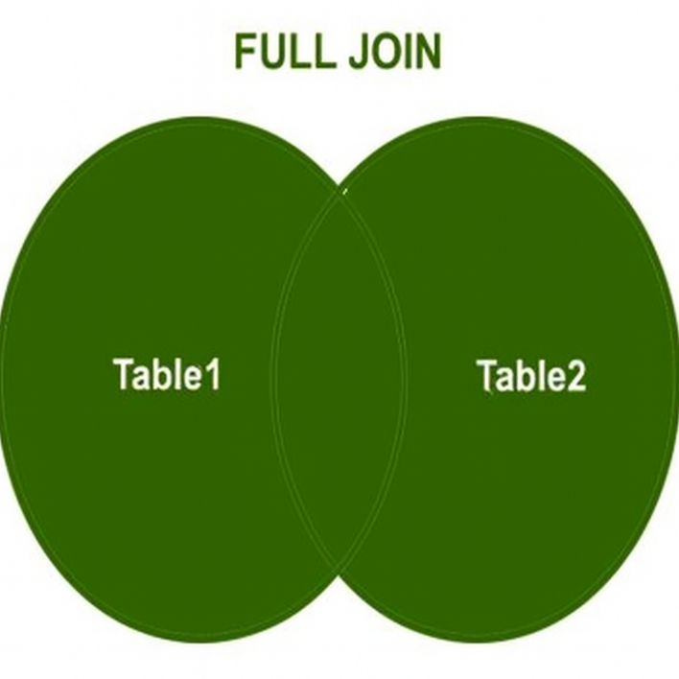
FULL JOINS
c. Full Join
A full join creates a new table by joining two tables as a whole. The joined table contains all records from both the tables and fill in NULLs for missing matches on either side. In this join we will use the union for joining the both tables.
Syntax:
Select * from Table 1 Left Join Table 2 ON
Table 1.Column 1=Table 2.Column 1
UNION
Select * from Table 1 Right Join Table 2 ON
Table 1.Column 1=Table 2.Column 1

Slide 16

SCENARIO

Slide 17
FULL JOINS
QUARY:
SELECT a.company_id AS "a.ComID", a.company_name AS "C_Name", b.company_id AS "b.ComID",
b.item_name AS "I_Name"FROM FULL OUTER JOIN foods b
ON a.company_id = b.company_id;
company a
RESULT:
a.ComID | C_Name | b.ComID | I_Name
16 | Akas Foods | 16 | Chex Mix
15 | Jack Hill Ltd | 15 | Cheez-It
15 | Jack Hill Ltd | 15 | BN Biscuit
17 | Foodies. | 17 | Mighty Munch
15 | Jack Hill Ltd | 15 | Pot Rice
18 | Order All | 18 | Jaffa Cakes
 |  |  | Salt n Shake
19 | sip-n-Bite.

Slide 18


